Slide 1
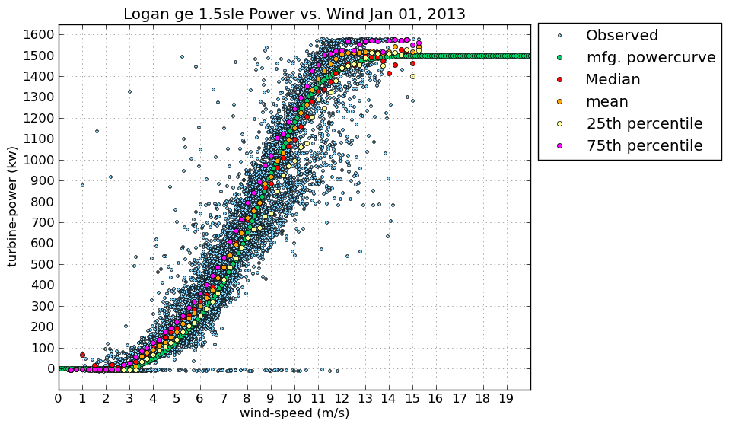
Python in Data Science
Image courtesy UCAR
Grayson Williams, Software Engineer
Mercedes-Benz Research and Development North America, Inc.
graysonw@gmail.com

Slide 2
Agenda
Introduction
Scientific Computing and Linear Algebra with Numpy
Data Structures and Analysis with pandas
Graphing and Visualization with Matplotlib
Machine learning with scikit-learn
Looking Forward
Julia

Slide 3
Agenda
Data Engineering
Hadoop
Spark
Other technologies (SQL, Redshift, BigQuery)

Slide 4
Numpy
Fundamental unit is array
Like lists in ‘base’ Python but much more efficient
array is fixed type, list is dynamic type
Can convert list to array with numpy.array([..])
Multidimensional and sparse arrays are supported
Difference: slices are views onto original data
Vectorized operations (ufuncs)
Perform operations on entire matrix rather than individual elements
Specify output, aggregates, outer products
Aggregations
min, max, avg, standard deviation
Standard matrix operations supported
Dot product, inversions, eigenvalues, etc.
Transform data
Combine, reshape, split, sort

Slide 5
pandas
Input/output
Read from CSV, Excel, HDF5, SQL, …
Series
Specialization of one-dimensional numpy array
Essentially a strongly-typed Python dict
Dataframes
Essentially a multidimensional series
Operations similar to both spreadsheets and relational databases
Time series
pandas originally designed for financial data
Timestamp
Period
Timedelta
Can also resample data

Slide 6
pandas
Database
Joins (inner/outer/cross)
Filter/sort/group by
Spreadsheet
Pivot table functionality
Data cleansing
Nulls and NaN values

Slide 7
Matplotlib
Output
To screen
To file (EPS, PNG, PDF, JPG, etc.)
Different types of plots supported
Linear, scatter, density/contour, histograms, 3D, geographical, visualization
Highly customizable
Colors, shapes, fonts, titles, axes scales, etc.
Supports plotting of error bars for statistical uncertainty
Integration with pandas
Series and Dataframe objects support a .plot() method

Slide 8
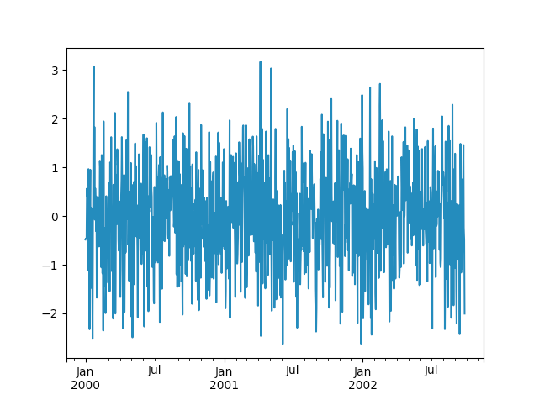
Matplotlib
import matplotlib.pyplot as plt
import numpy as np
ts = pd.Series(numpy.random.randn(1000), index=pd.date_range('1/1/2000', periods=1000))
ts.plot()

Slide 9
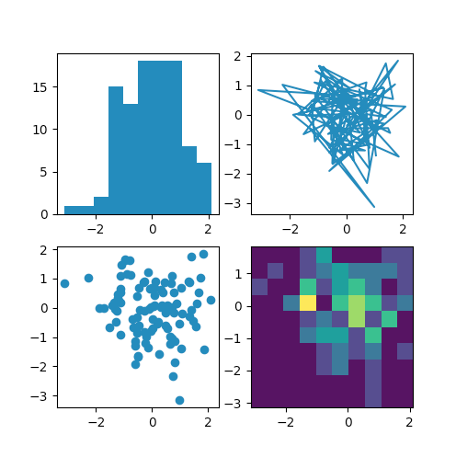
Matplotlib
import pandas as pd
import numpy as np
np.random.seed(19680801)
data = np.random.randn(2, 100)
fig, axs = plt.subplots(2, 2, figsize=(5, 5))
axs[0, 0].hist(data[0])
axs[1, 0].scatter(data[0], data[1])
axs[0, 1].plot(data[0], data[1])
axs[1, 1].hist2d(data[0], data[1])
plt.show()

Slide 10
Scikit-learn
Supervised learning
Classification
Regression
Unsupervised learning
Clustering
Association
Steps
Choose model
Choose parameters
Arrange data as necessary
Fit model

Slide 11

Looking forward
Performance vs ease-of-use
C++/Java vs Python/R
Julia seeks to combine the two
Feels like a scripting language, performs like a compiled language
Julia is JIT compiled instead of interpreted
Developed since 2009, available since 2012
Designed from the ground up for analytics
Features like parallelism/multiprocessing
Watch this space!
Version 1.0.0 released on August 8
Python still much older/richer ecosystem

Slide 12

Hadoop
Written in Java, but has Python client
HDFS is distributed file system
Implementation of MapReduce for large datasets
MapReduce has two (optionally, three) components:
Mapper:
Performs the actual work, e.g. counts words and sends results to reducer
Combiner:
Semi-reducer, serves as an additional step to break down problems
Reducer:
Aggregates results
Quick way to solve embarrassingly parallel problems

Slide 13

Spark
In-memory cluster compute framework
Supports Python and Scala
Scala is faster because of static typing
Kind of like Hadoop in functionality, but much faster
Features include streaming, in-memory machine learning
Fundamental core is resilient-distributed database (RDD)
Can work with e.g. Cassandra or HDFS

Slide 14
Others
Python is a natural tool for hitting REST APIs and devising Extract Transform Load (ETL) jobs
Has orchestration frameworks such as Luigi and Airflow
Other toolsets include e.g. Singer (tool used in-house for Stitch ETL service)
Task/target paradigm
Native support and supplier-provided SDKs for cloud databases e.g. Google BigQuery and Amazon Redshift
Most data sources have Python clients available, like SalesForce

Slide 15
Conclusion
Python is a very flexible language for data science and data engineering
Probably the most useful one overall!
Other technologies may be preferable in certain scenarios
For example, Java for performance
Python plays well with others!

Slide 16
Further Resources
https://jakevdp.github.io/PythonDataScienceHandbook
https://julialang.org
http://ipython.org
https://jupyter.org
http://www.numpy.org
https://scipy.org
https://matplotlib.org
https://www.datacamp.com/community/tutorials/apache-spark-python
https://spark.apache.org
http://hadoop.apache.org
https://www.singer.io

